Slide 1



“LIAR” Fake News Detection
Columbia Lions Team
Jincheng Xu
Jiaqing Chen
Nareerat Tricheewannad
Kevin Denvis
Notes:
Hello everyone, today I am gonna present our work “LIAR” Fake News Detection.

Slide 2
Why this topic?
Huge Number of Fake News!
poses serious threats to the integrity of journalism & created turmoil in the political world
Notes:
So, why this topic?
Because we are now in a world with tremendous amount of news popping up every day. And some of them may be fake news, which will pose serious threats to the integrity of journalism and created turmoil in the political world.

Slide 3
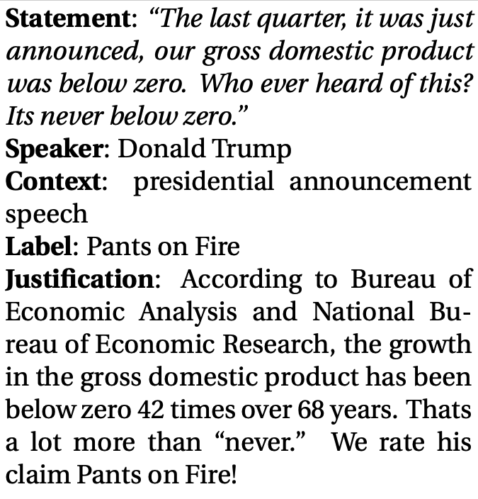
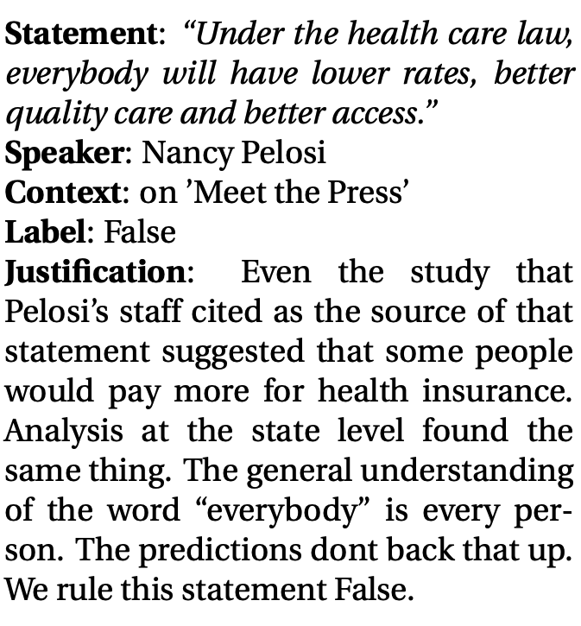
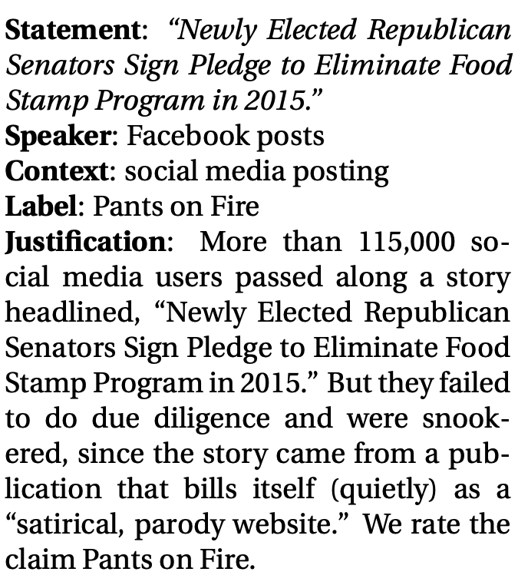
What we have?
a decade-long, 12.8K manually labeled short statements in various contexts from POLITIFACT.COM
Notes:
What we have now is a decade-long, 12.8K manually labeled short statements in various contexts from POLITIFACT.COM
For example, see the middle statement here, which was said by Donald Trump. He said that the gross domestic product was never below zero. This statement happened in the presidential announcement speech as described in the context. And we label it pants on fire, which means the news is absolutely fake cause the gross domestic product has been below zero 42 times over the past 68 years as clarified in the justification.

Slide 4


Table of Contents
01
02
Word Cloud
03
Data Processing
Statistical Analysis
04
05
06
Sentiment Analysis
Model Prediction
Model Analysis
+ Multiple interesting findings…
Notes:
So let’s move to the table of contents.
I am gonna introduce the data processing, word cloud, and statistical analysis part. And my teammate is going to do the following parts and clarify our interesting findings.

Slide 5
01
Data Processing
Notes:
The first part is Data Processing.

Slide 6
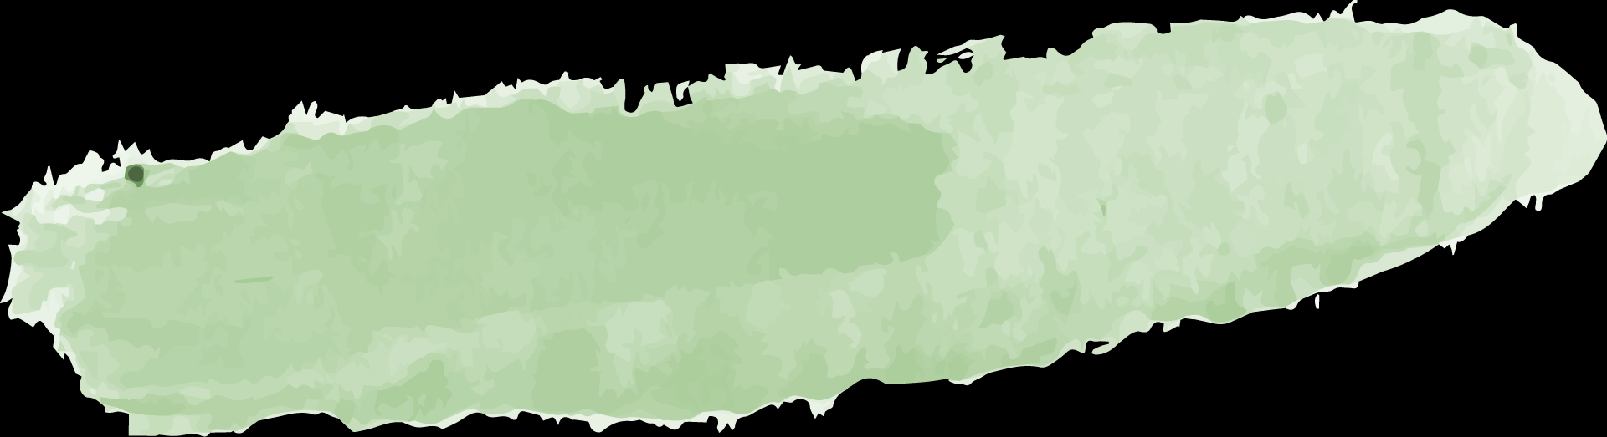



Text Pre-processing
01
Basic Processing
Remove punctuation, lowercase…
02
Tokenization
”writing a slide” 🡪 [ ‘writing’, ‘a’, ‘slide’ ]
03
Remove stop words
[ ‘writing’, ‘a’, ‘slide’ ] 🡪 [ ‘writing’, ‘slide’ ]
04
Stemming
[ ‘writing’, ‘slide’ ] 🡪 [ ‘write’, ‘slide’ ]
Notes:
What we have is raw statements happened in our daily life. To make them suitable for training, we need to pre-process the data, which we divide the process into four steps. The first step is basic processing like removing punctuation and converting all the letters to lowercase. The second step is tokenization, which we split a statement into separate words. And then we move on to the third step, which is removing stop words like ‘a’, ‘the’ that doesn’t have actual meaning in the analysis. The last step is stemming, which we will convert words to its root form, like ‘writing’ to ‘write’.

Slide 7
02
Word Cloud
Notes:
And now the second part is word cloud.

Slide 8
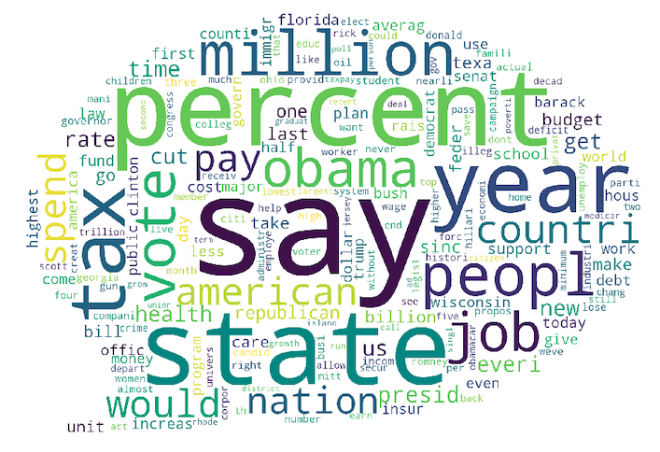
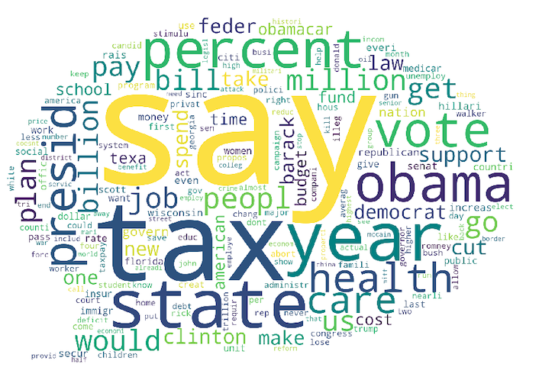

Word frequency 🡪 Character of fake news
“True” / “mostly true” news
“False” / “barely true” news
Almost no differences !
True news is more specific (ex. use more “percent”)
Fake news like referencing other people (ex. more “says”)
Fake news prefer health-related topics (ex. more “health”, “care”…)
Notes:
As we can see here, we draw two word clouds for true news and fake news. The bigger the word, the more it appears in the statements. So, compare this two word clouds, we can say that there are almost no differences. Some slight differences may be that true news use more specific words like ‘percent’ and ‘million’. But fake news may prefer to use the word ‘say’, because many fake news are pretending to reference other people. Also, fake news are more frequent in the health-related topics.

Slide 9
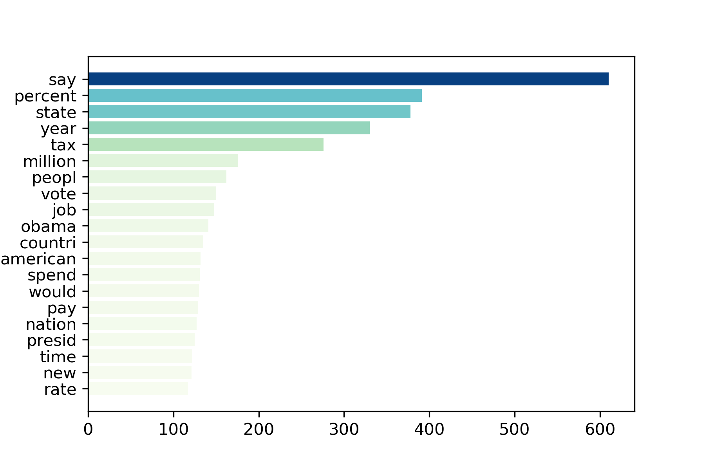
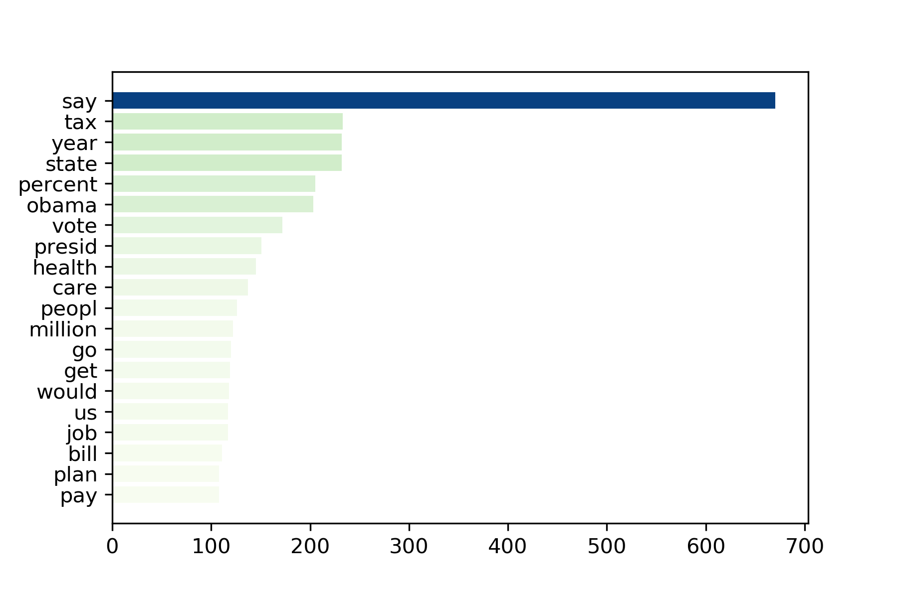
Top 20 word using
“True” / “mostly true” news
“False” / “barely true” news
Notes:
Here we show the top 20 words used in true news and fake news.
As we just concluded, real news have more precise words like ‘percent’, fake news have more words related to health-care.

Slide 10
03
Statistical Calculation - based on category
Notes:
Now we are going to the third part, Statistical Calculation based on category.

Slide 11
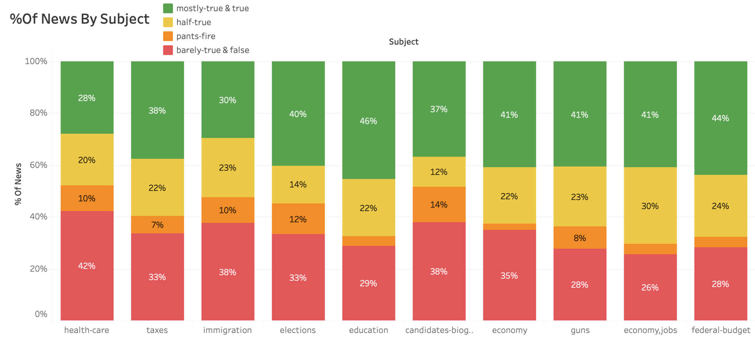
Economy and Education fields have less percentage of fake news.
Health Care fields tend to have more fake news
Health department of the government should feed more accurate news to people
Notes:
The first is the distribution over the subject category. We sample the top 10 subjects that have the most news statements. As we can see here, Economy and Education fields have less percentage of fake news. But Health Care fields tend to have more fake news, as we just saw in the fake news word cloud. As a result, Health department of the government should feed more accurate news to people.

Slide 12
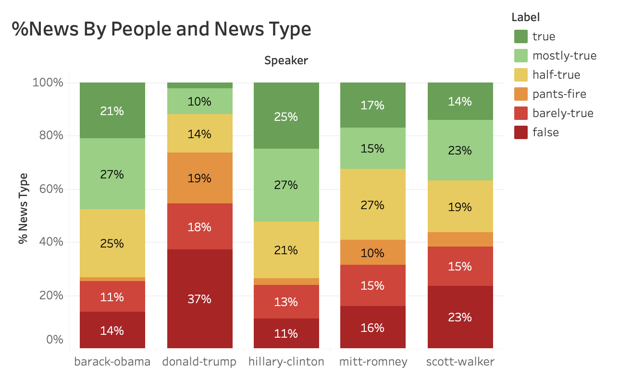
Barack Obama & Hillary Clinton seldom create fake news while Donald Trump has high potential in creating fake news
We should keep monitoring news posted by Donald Trump
Notes:
Now let’s move on to the people category. We can see here Barack Obama & Hillary Clinton seldom create fake news while Donald Trump has high potential in creating fake news. It is like over half of his statements are fake news while he enjoys accusing others of spreading fake news. So we should probably keep monitoring news posted by Donald Trump.

Slide 13
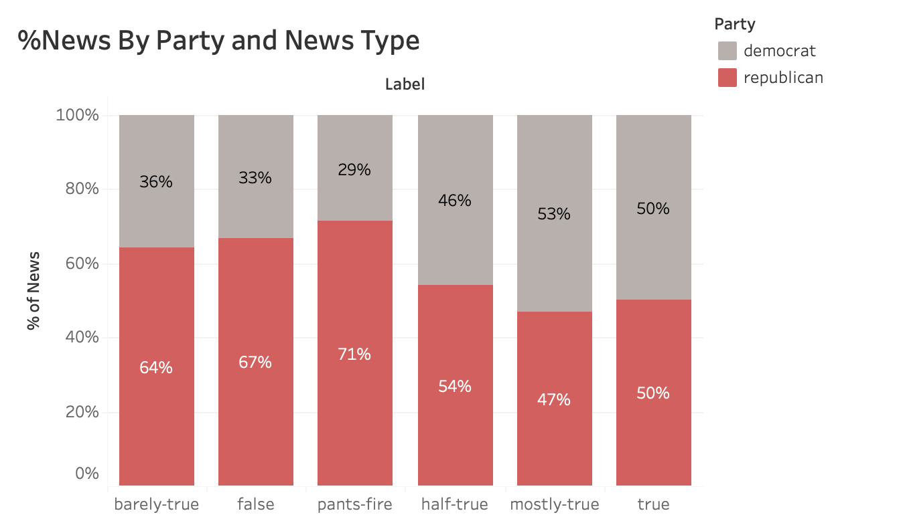
Republican party tends to make more fake news compared to Democrats
Party could have high correlation with speaker variable
Notes:
Now we are moving to the party category. We can see that comparing democrats with republican, they are close in telling the truth. However, republican tend to tell more fake news than democrats.

Slide 14
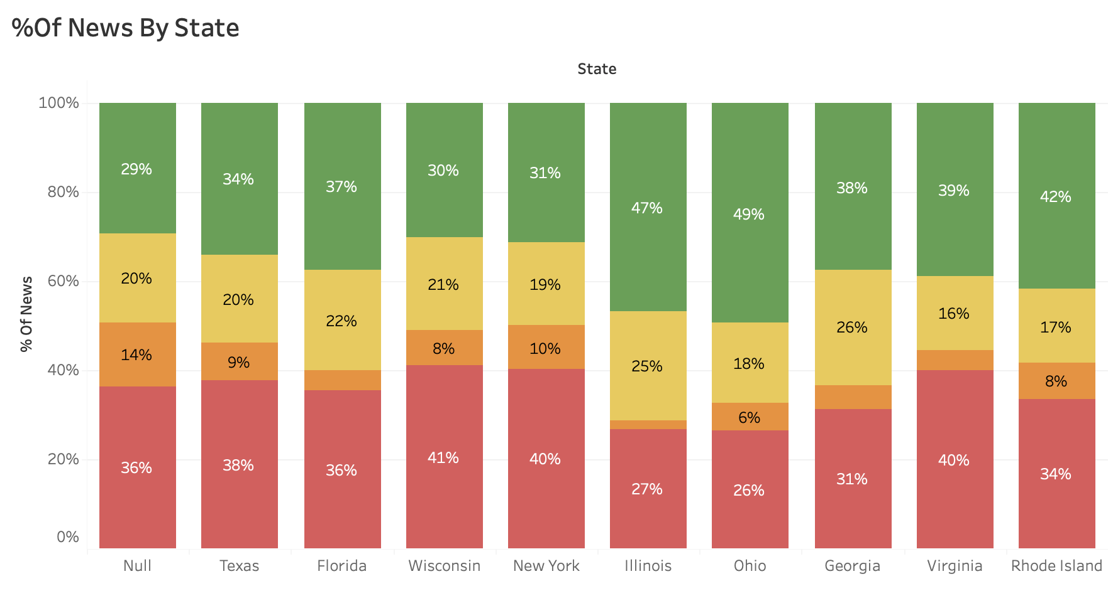
Illinois and Ohio create less fake news compared to other states While almost half of news in New York and Wisconsin are fake news
New York and Wisconsin government state should monitor fake news closely
Notes:
The last category is the state. We can see that Illinois and Ohio create less fake news compared to other states While almost half of news in New York and Wisconsin are fake news. So, I suggest that New York and Wisconsin government state should monitor fake news closely.

Slide 15
04
Sentiment Analysis

Slide 16
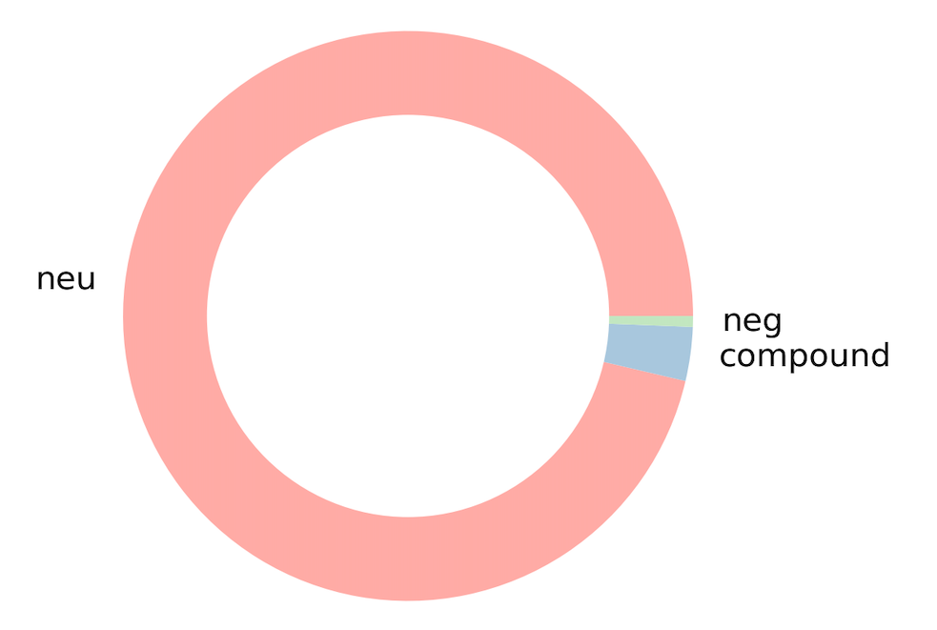
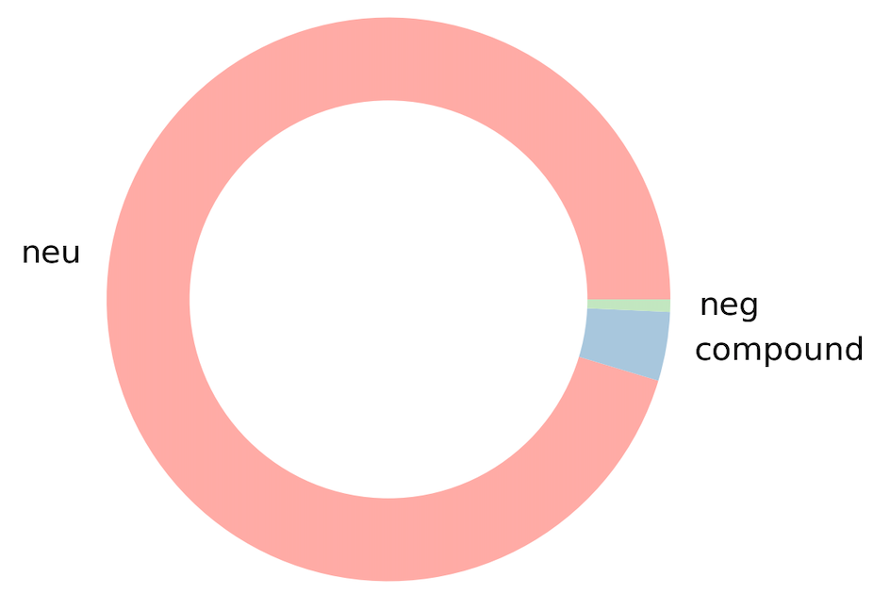

VADER Model
🡪 Justify the positive level and negative level of a text
True
Mostly-True
News
False
Barely-True
News
More emotional content appears in fake news
96% Neutral
3% Compound
<1% negative
<1% positive
95% Neutral
4% Compound
<1% negative
<1% positive

Slide 17
05
Model Prediction

Slide 18
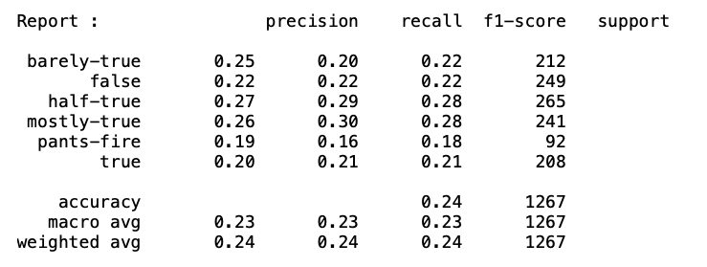
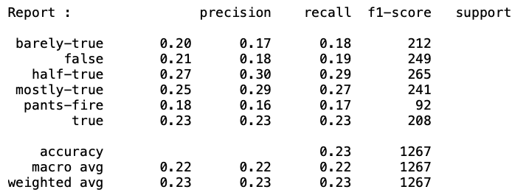

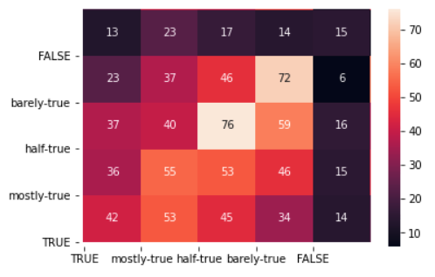
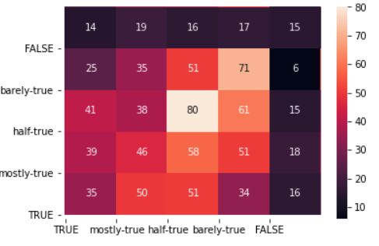
Naive Bayes
Bernoulli Naive Bayes
Multinomial Naive Bayes

Slide 19
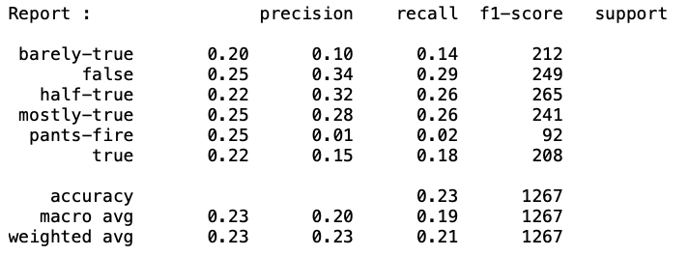

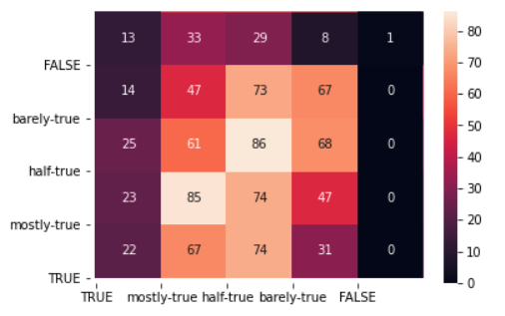
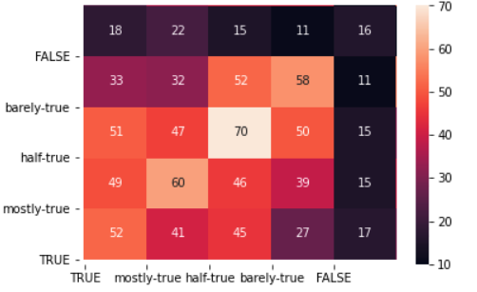
Logistic Regression
SVM

Slide 20
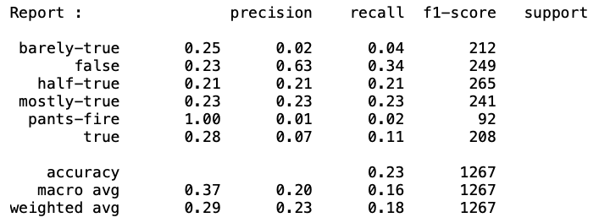
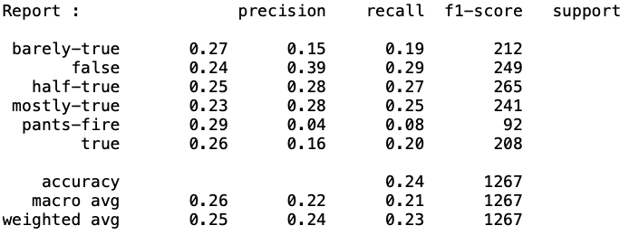
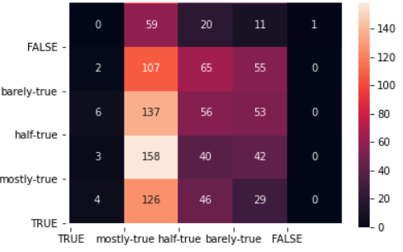
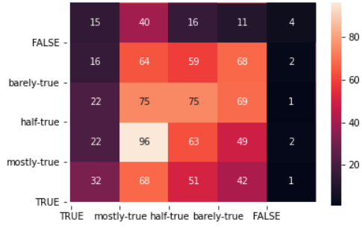
Adaboost
Random Forest

Slide 21
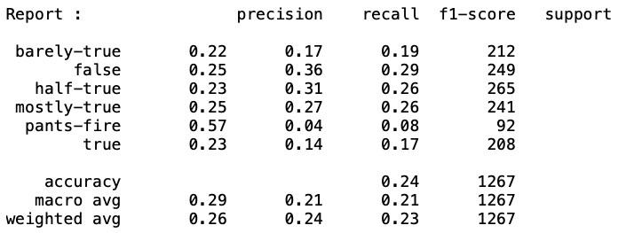
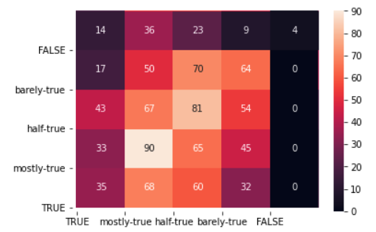
Ensemble
(with Random Forest, SVM, Logistic Regression)

Slide 22
06
Model Analysis

Slide 23
Model | Training Accuracy | Testing Accuracy | Precision | Recall | F-1 Score
Bernoulli Naive Bayes | 0.6873 | 0.2399 | 0.24 | 0.24 | 0.24
Multinomial Naive Bayes | 0.6802 | 0.2328 | 0.23 | 0.23 | 0.23
Logistic Regression | 0.4995 | 0.2312 | 0.23 | 0.23 | 0.21
SVM | 0.8790 | 0.2423 | 0.24 | 0.24 | 0.24
AdaBoost | 0.2432 | 0.2281 | 0.29 | 0.23 | 0.18
Random Forest | 0.9992 | 0.2439 | 0.25 | 0.24 | 0.23
Ensemble | 0.8858 | 0.2391 | 0.26 | 0.24 | 0.23

Slide 24



Observations
All models have low testing accuracy, even if training accuracy can be high → The text prediction is hard to generalize.
In terms of accuracy, Random Forest and SVM work better!
From the confusion matrix, Naive Bayesian, SVM and logistic regression work well for “half-true” category, while AdaBoost, Random Forest and Ensemble work well for “mostly-true” text.

Slide 25
Conclusion
Fake news is hard to recognize based on only text information. Context is important!
There are still some rules to recognize that. For example, the fake news can be more emotional.
Traditional machine learning models have the ability to distinguish the case they have met, but they are hard to generalize.
Next steps: Improve models by adding more relevant features such as headers of the news

Slide 26
References
Wang, W. Y. (2017). " liar, liar pants on fire": A new benchmark dataset for fake news detection. arXiv preprint arXiv:1705.00648.

Slide 27
THANKS

